Slide 1

Email Marketing Campaign Success Prediction Group 2: 1. Umme Umara Savantwadi 2. Karthick 3.Vinutha 4.Abhijeet Sudam Pawar 5.Komal Dadarao Ghatol 6.Gugoloth Supriya

Slide 2
INTRODUCTION
Email Marketing Campaign Success Prediction helps companies to predict whether a customer will open a E-mail in marketing campaign.
Why E-mail marketing matters:
Email marketing is a cost-effective way to reach customers, but success depends on engagement, particularly email open rates.
Problem Statement:
"The goal of this project is to predict whether a customer will open an email, helping marketing teams optimize their campaigns and improve engagement."

Slide 3
PROJECT OBJECTIVE
Build a machine learning model to predict whether a customer will open an email.
Identify key factors influencing customer engagement.
Use insights to segment audiences and create tailored campaigns.
Improve campaign targeting to increase conversion rates.
Optimize marketing resources by focusing on effective strategies.
Optimize engagement, reduce marketing costs, and enhance campaign performance.

Slide 4
DATASET DISCRIPTION
The dataset contains the information of 1000 E-mail marketing campaign customer variables that help in understanding customer behavior, engagement, and interactions with email marketing campaigns.Here’s a breakdown
Details of the Dataset used: Customer_Age,Emails_opened,Emails_clicked,Purchase_History,Time_spent_on_website,Days_since_last_open,Customer_engagement_score,Opened_previous_emails,Clicked_previous_emails and Device_type
Target Variable: Opened_previous_emails Status-(0:Not opened,1:Opened)
Numerical variables: Customer_Age,Emails_opened,Emails_clicked,Purchase_History,Time_spent_on_website,Days_since_last_open,Customer_engagement_score
Categorical/Binary variables: Opened_previous_emails,Clicked_previous_emails,Device_type

Slide 5
EXPLORATORY DATA ANALYSIS (EDA)
Get to Know the Data: Load the dataset and Understand what’s in the dataset—basic customer info.
Clean Up the Data: Handle any missing values, check for duplicate rows, and ensure data types look right.
Spot Trends and Patterns: Understand patterns in customer engagement,Frequency of email opens, clicks, and customer preferences.
Visualize Key Insights: Use simple charts like Histogram,Pairplot,Boxplot etc.. to detect Outliers and identify any clear patterns of Customer Emails.

Slide 6
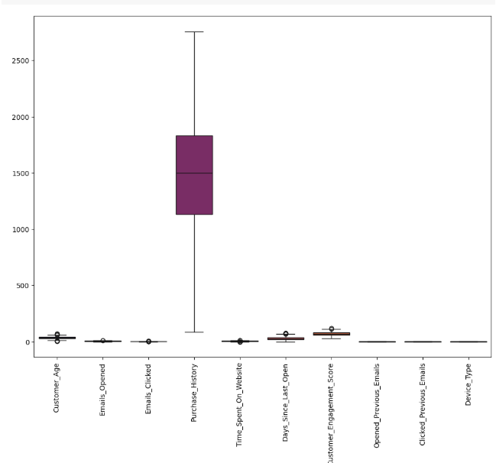
FEATURE DISTRIBUTIONS
Box Plot:
plt.figure(figsize=(12,9))
sns.boxplot(df,palette='inferno')
plt.xticks(rotation=90)
plt.show()

Slide 7
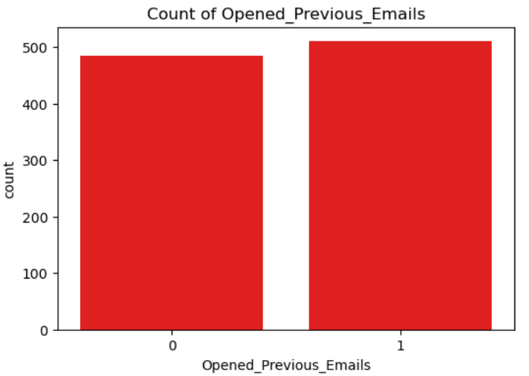
COUNT PLOT
Count plot (Target variable):
count=['Opened_Previous_Emails','Clicked_Previous_Emails','Device_Type']
for i in count:
plt.figure(figsize=(6,4))
sns.countplot(data=df, x=i, color='Red')
plt.title(f'Count of {i}')
plt.show()

Slide 8
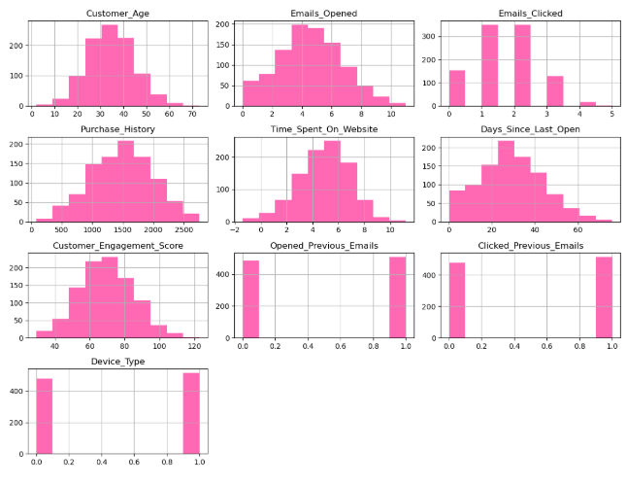
HISTOGRAM
Code:
df.hist(figsize=(12,9),color='Hotpink')
plt.tight_layout()
plt.show()

Slide 9
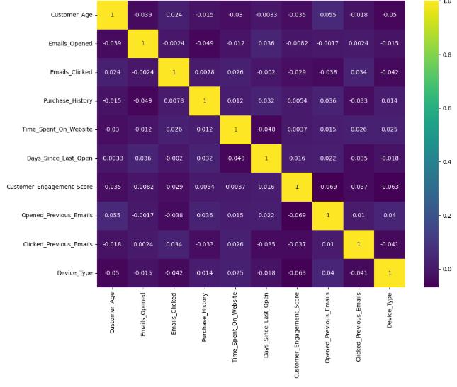
CORRELATION MATRIX
Code:
plt.figure(figsize=(12,9))
sns.heatmap(df.corr(numeric_only=True),annot=True,cmap='viridis')
plt.xticks(rotation=90)
plt.show()

Slide 10
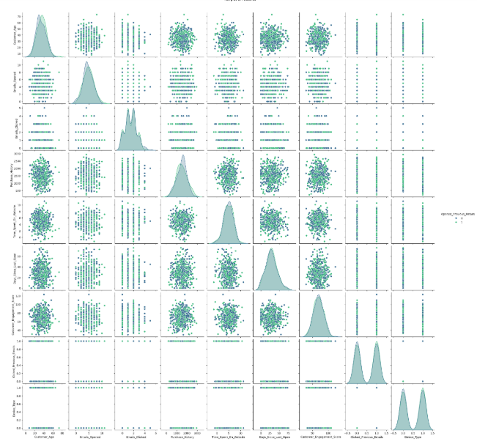
PAIRPLOT
Code:
plt.figure(figsize=(15,9))
sns.pairplot(df,palette='cividis',hue='Opened_Previous_Emails')
plt.show()

Slide 11
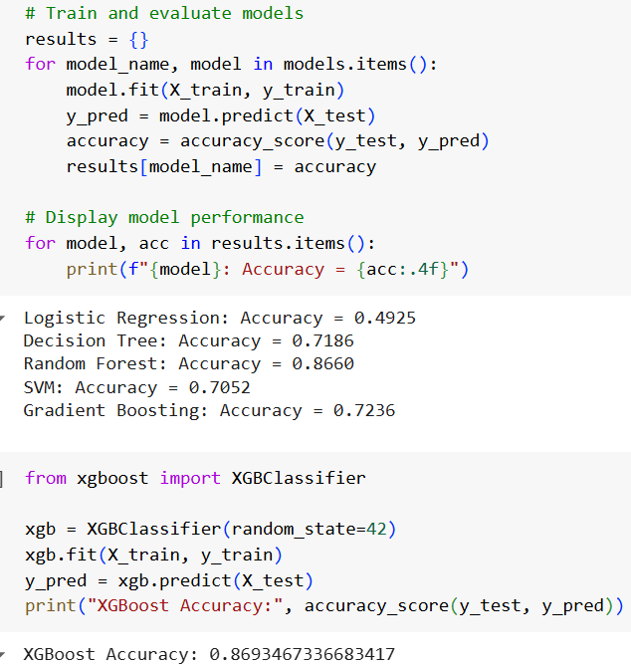
Model Selection and Development
Models Considered: We trained several models, including Logistic Regression, Random Forest, Support Vector Machines (SVM) and Gradient Boosting But we have got the highest accuracy in XGBOOST Model without Hyperparameter tuning.

Slide 12
STREAMLIT
Streamlit allows you to quickly create web apps that are interactive and easy to use. It turns your Python code into a fully functioning app in just a few lines. In this case, it’s helping to make E-mail Marketing Campaign predictions accessible and understandable to anyone, without needing complex technical knowledge.
This Streamlit E-mail Marketing Campaign application let you quickly predict whether a customer opened a previous e-mail based on their data and input features. By entering simple information like how long they spent time on website(hrs),customer engagement score and how long days since customer last open e_mail and customers device type the app tells you whether the customer opened e-mail or not.

Slide 13
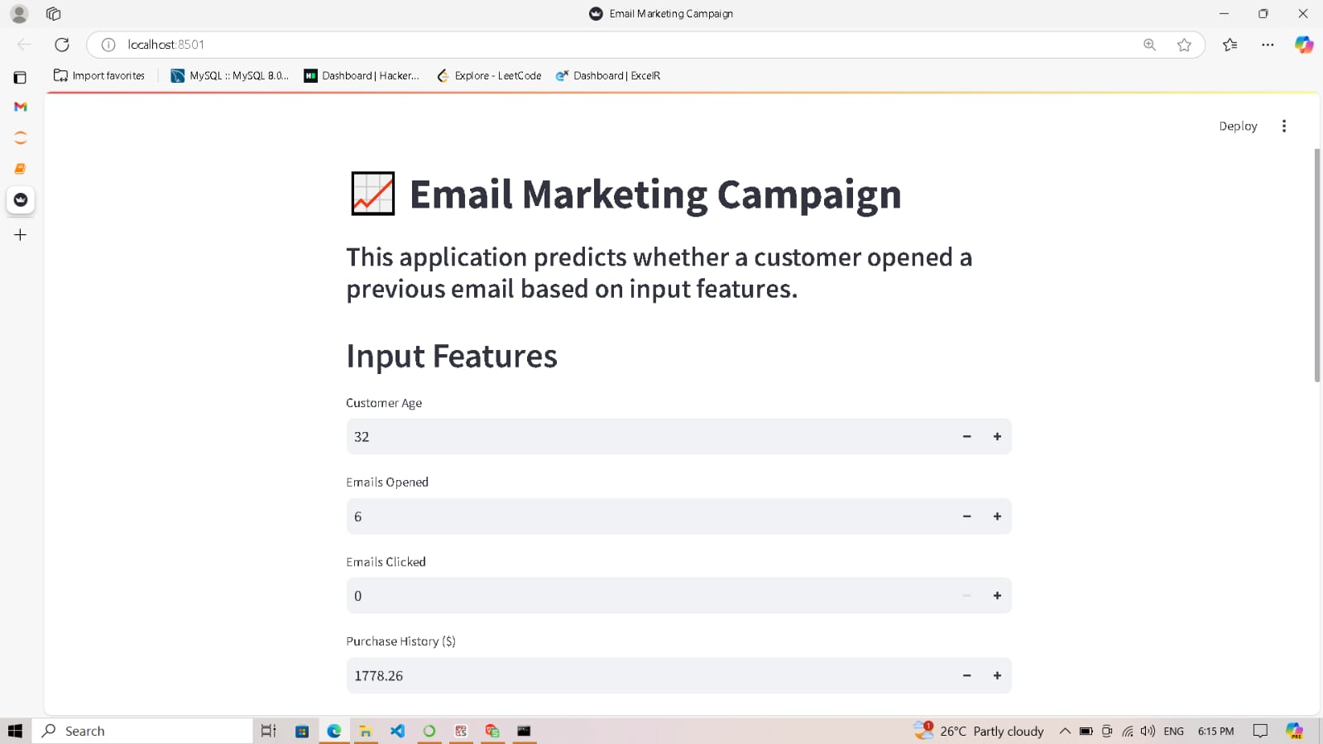
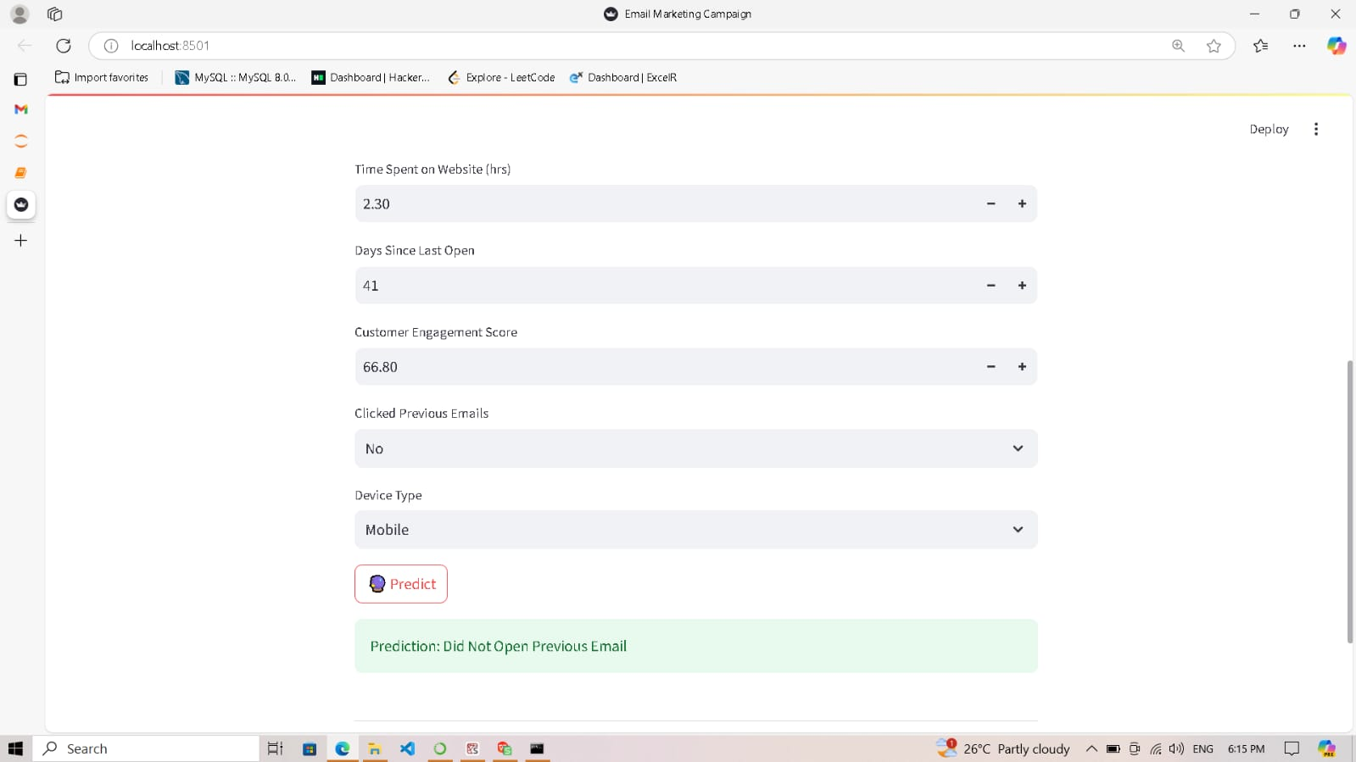
E-MAIL MARKETING CAMPAIGN PREDICTION(STREAMLIT)

Slide 14




CONCLUSION
Why E-mail marketing matters:Predicting whether customer opened previous e-mail or not is a game changer for Marketing companies. It helps to influencing customer engagement., so the company can step in early with targeted efforts to keep them satisfied.
What We Learned:By using machine learning techniques like decision trees,random forests and xgboost, we can predict opened previous e-mail based on patterns in customer behavior, usage, and demographics. This means we can Improve campaign targeting to increase conversion rates.
Impact on the Business:With these insights, Marketing companies can craft more effective marketing strategies and reduce marketing costs, and enhance campaign performance. and boosting revenue.
What’s Next:In the future, using real-time data and exploring more advanced techniques like deep learning could help take E-mail prediction campaign to the next level, making it even more precise and personalized

